Slide 1
Week-3
COSC 32001 Computer Vision
Noopa Jagadeesh
Date: 25 Jan 2024

Slide 2
Recap
Digital Images
Python libraries for image analysis
Application-Color Recognition using HSV Colorspace

Slide 3
Agenda
Template Matching
Image Segmentation
Data Augmentation

Slide 4
Template Matching

Slide 5
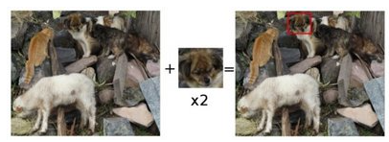
Template Matching
https://docs.opencv.org/3.4/de/da9/tutorial_template_matching.html
Template matching is a technique for finding areas of an image that match (are similar) to a template image (patch).
While the patch must be a rectangle it may be that not all of the rectangle is relevant. In such a case, a mask can be used to isolate the portion of the patch that should be used to find the match.
How does it work?
We need two primary components:
Source image (I): The image in which we expect to find a match to the template image
Template image (T): The patch image which will be compared to the source image
our goal is to detect the highest matching area

Slide 6
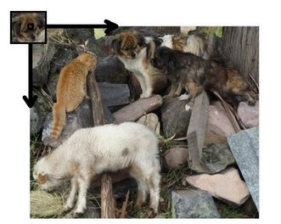
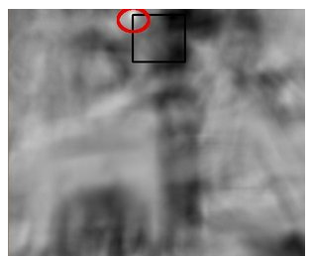
Template Matching
To identify the matching area, we have to compare the template image against the source image by sliding it.
By sliding, means moving the patch one pixel at a time (left to right, up to down). At each location, a metric is calculated so it represents how "good" or "bad" the match at that location is (or how similar the patch is to that particular area of the source image).
For each location of T over I, you store the metric in the result matrix R. Each location (x,y) in R contains the match metric:
This image is the result R of sliding the patch with a metric TM_CCORR_NORMED. The brightest locations indicate the highest matches. The location marked by the red circle is probably the one with the highest value, so that location (the rectangle formed by that point as a corner and width and height equal to the patch image) is considered the match.

Slide 7
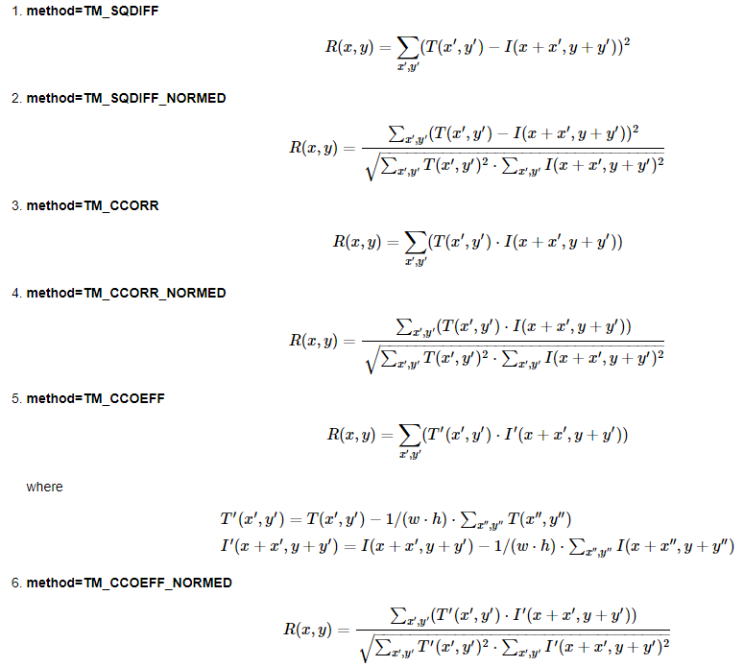
Template Matching
Patch image contains information about the feature or the object of interest and we are going to slide this tiny patch image on to the source image and then use statistics to find out how well that match.
A common statistics we use statistics is mean square difference between the template image and the source image.
Traditional template matching lacks scale invariance . Scale Invariance means that the detection of the object does not depend on its size in the image. In other words, if an object appears larger or smaller due to being closer or further away from the camera, a scale-invariant method would still be able to detect it.
Traditional template matching is not scale invariant because it relies on the template and the target region being of the same size and orientation. If the object in the target image is larger or smaller than the template, or if it has been resized in any way, the template matching algorithm may fail to detect it.
To match objects of different sizes, we would need to use multiple templates of different scales or resize the target image to match the template's scale.
In order to make template matching scale-invariant, techniques such as pyramidal search (where the target image is repeatedly scaled down and the template is matched at each scale) or feature-based methods (which are inherently scale-invariant, like SIFT - Scale-Invariant Feature Transform) can be used. These methods allow the algorithm to detect objects regardless of their size variations in the image.
Notes:
Square difference--value should be low, square difference normalized, cross correlation—value would be high.

Slide 8
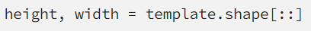
Object Detection using Template Matching
When the template image is slid over the source image, it’s looking for the entire region. (top-left corner as the reference frame). After the template image matches the source image, we would like to note the top-left corner location and then draw a box around the region where it actually matches. In order to do that we need to find the height and width of this template image. So we can draw the rectangle.
Template matching is part of OpenCV and it takes our grayscale source image and the template image with the statistical metrics we need to use. In our case, I’m using the Minimum Square Difference (TM_SQDIFF) and we are looking for the minimum difference between the template image and the source image.

Slide 9
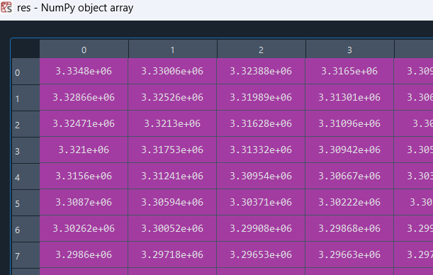
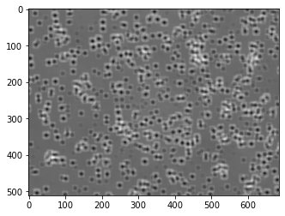
Object Detection using Template Matching
If you plot ‘res’, we’ll see a probability map. As we can see from the image above, these tiny dots are where the template actually matched. Wherever we see a dark region or dark spot that's where the top left corner of our template matches with minimum value of square difference. That means that's a good match.

Slide 10
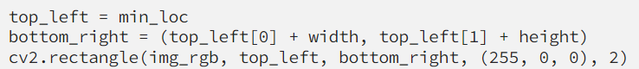
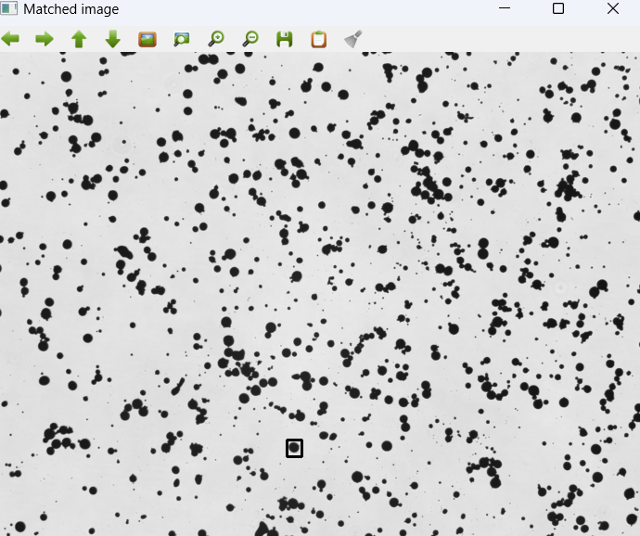
Object Detection using Template Matching
Next we need to draw a rectangle on the source image where the template image matches.
Using minMaxLoc(res) we can extract the minimum value, maximum value, minimum location, and maximum location.
To draw a blue rectangle on the source image where the template image matches, we need to get the minimum location, min_loc(where match actually starts) as our top left. The same way, we can get our bottom right by top_left[0] + width and top_left[1] + height. With these dimensions, we can draw the blue rectangle using cv2.rectangle.
Getting one match is not what
we're probably looking for in most
applications. We want to see other
regions that match this template within
certain degree of acceptance.

Slide 11
Detect Multiple Objects — Under a Given Threshold
We already did the detecting of one object by selecting the minimum difference between source and template images. By defining a threshold we can detect all the objects that are similar to our template image.
Here we use TM_CCOEFF_NORMED because we need to get the maximum values, not the minimum values. Which means we need to look for multiple objects instead of one.

Slide 12
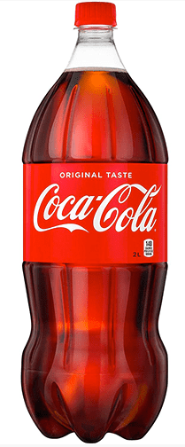
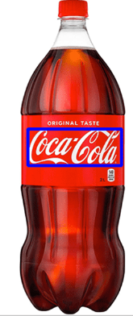

OpenCV Template Matching
Template matching is arguably one of the most simple forms of object detection:
It’s simple to implement, requiring only 2-3 lines of code
Template matching is computationally efficient
It doesn’t require us to perform thresholding, edge detection, etc., to generate a binary image (such as contour detection and processing does)
And with a basic extension, template matching can detect multiple instances of the same/similar object in an input image
Of course, template matching isn’t perfect. Despite all the positives, template matching quickly fails if there are factors of variation in your input images, including changes to rotation, scale, viewing angle, etc.
If your input images contain these types of variations, you should not use template matching — utilize dedicated object detectors including HOG + Linear SVM, Faster R-CNN, SSDs, YOLO, etc.
But in situations where you know the rotation, scale, and viewing angle are constant, template matching can work wonders.
Even small, minor deviations in appearance can dramatically affect template matching results and render it effectively useless.

Slide 13
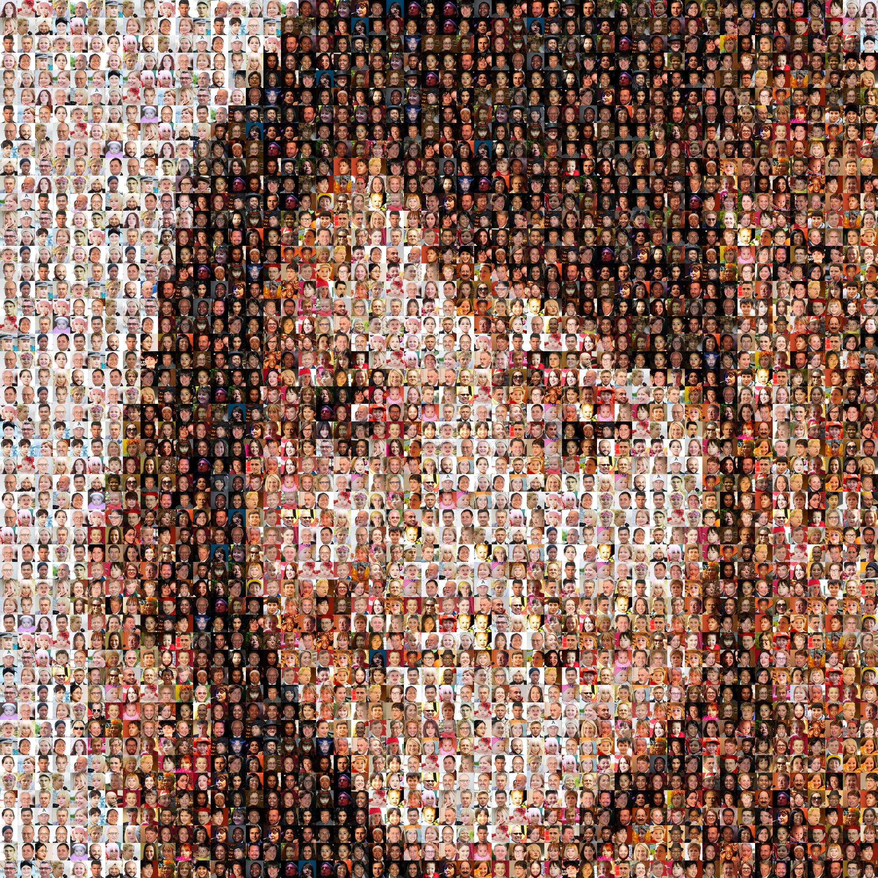
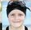

OpenCV Template Matching-Photo Mosaic
Take the large template image and progressively resize it to overlay on the large image.
For each of the scaling factors we are going to resize our template image, use that resized image to do the template matching and extract the min_val and min_loc and check it. i.e. if the current min_val is less than the previous min_val, then update best_match. If not keep the previous values
https://github.com/NVlabs/ffhq-dataset

Slide 14
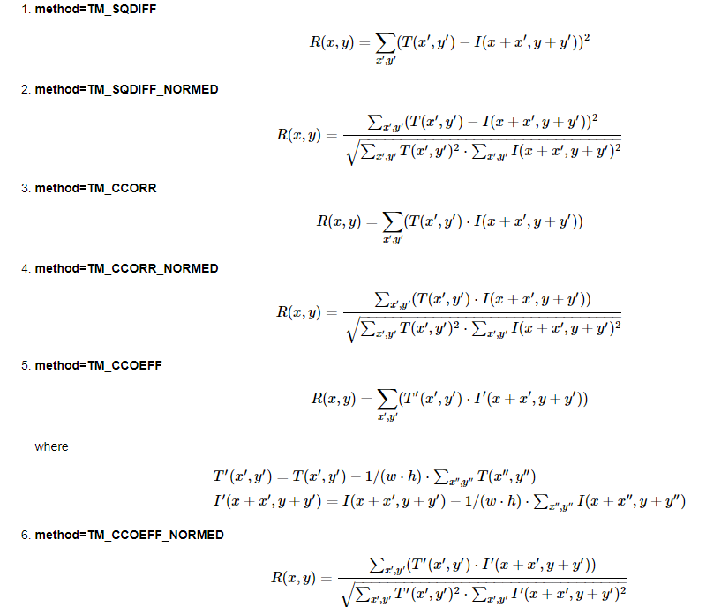
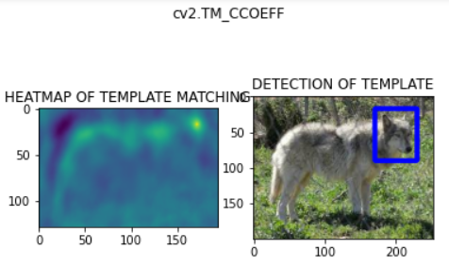
Which are the matching methods available in OpenCV?
https://docs.opencv.org/3.4/de/da9/tutorial_template_matching.html
OpenCV implements Template matching in the function matchTemplate(). The available methods are 6:

Slide 15
Image Segmentation

Slide 16
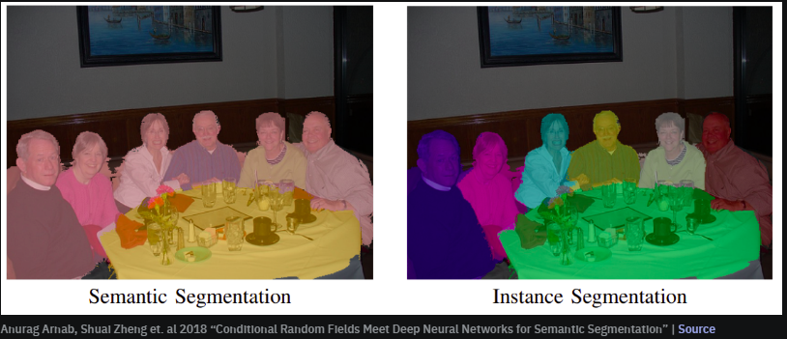
Image Segmentation
Image segmentation is a commonly used technique in digital image processing and analysis to partition an image into multiple parts or regions, often based on the characteristics of the pixels in the image.
Image segmentation involves dividing an image into meaningful regions or segments.
Image segmentation could involve separating foreground from background, or clustering regions of pixels based on similarities in color or shape. For example, a common application of image segmentation in medical imaging is to detect and label pixels in an image or voxels of a 3D volume that represent a tumor in a patient’s brain or other organs.
This is the process of dividing an image into multiple segments. In this process, every pixel in the image is associated with an object type. There are two major types of image segmentation — semantic segmentation and instance segmentation.

Slide 17
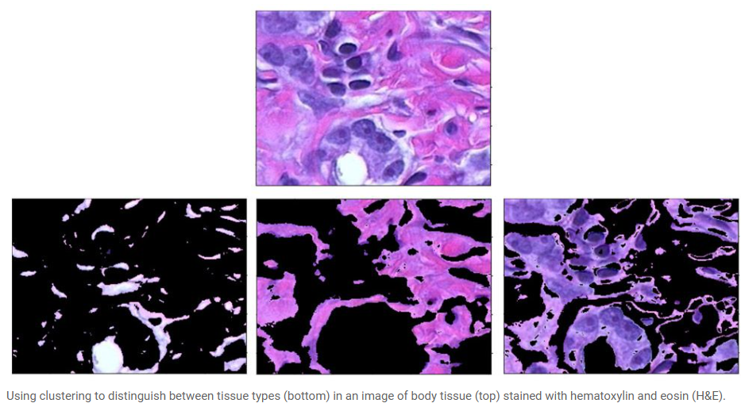
Image Segmentation
Several algorithms and techniques for image segmentation have been developed over the years using domain-specific knowledge to effectively solve segmentation problems in that specific application area. These applications include medical imaging, automated driving, video surveillance, and machine vision.
Medical Imaging
During medical diagnosis for cancer, pathologists stain body tissue with hematoxylin and eosin (H&E) to distinguish between tissue types. They then use an image segmentation technique called clustering to identify those tissue types in their images. Clustering is a method to separate groups of objects in a scene. The K-means clustering algorithm finds separations such that objects within each cluster are as close to each other as possible, and as far from other objects in other clusters as possible.

Slide 18
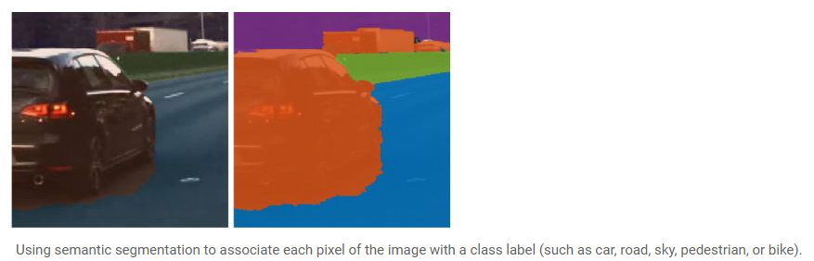
Image Segmentation
Autonomous Driving
When designing perception for autonomous vehicles, such as self-driving cars, semantic segmentation is popularly used to help the system identify and locate vehicles and other objects on the road.

Slide 19
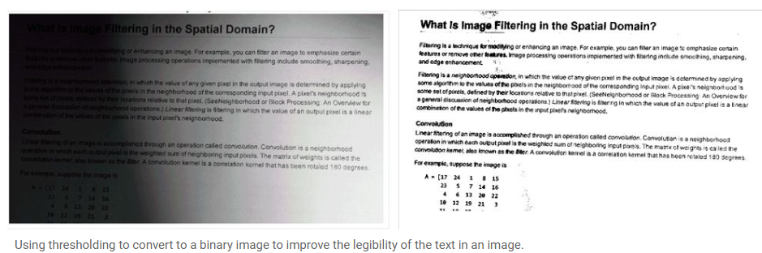
Image Segmentation
A common technique is to look for abrupt discontinuities in pixel values, which typically indicate edges that define a region.

Slide 20
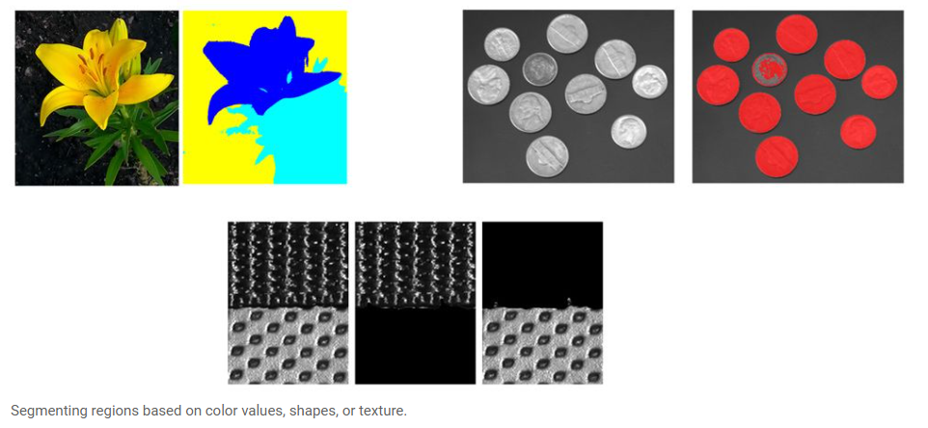
Image Segmentation
Another common approach is to detect similarities in the regions of an image. Some techniques that follow this approach are region growing, clustering, and thresholding.
A variety of other approaches to perform image segmentation have been developed over the years using domain-specific knowledge to effectively solve segmentation problems in specific application areas.

Slide 21
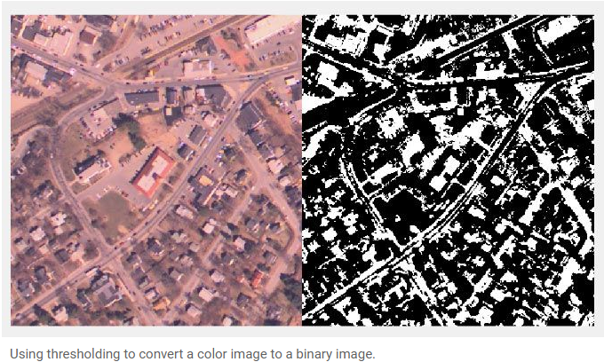
Types of Image Segmentation
Thresholding
Threshold-based segmentation is one of the simplest and most commonly used techniques. It involves setting a threshold value to separate pixels into different regions based on their intensity or color values. This technique is effective when the objects of interest have distinct intensities or colors compared to the background
Basic thresholding techniques include global and adaptive thresholding. Global thresholding applies a fixed threshold value to the entire image, while adaptive thresholding determines different threshold values for different image regions based on local characteristics.
Challenges and limitations of threshold-based segmentation include sensitivity to lighting conditions, noise, and the need for manual parameter tuning.
Practical examples and use cases include segmenting objects in medical images, document processing, and simple object detection in surveillance systems.

Slide 22
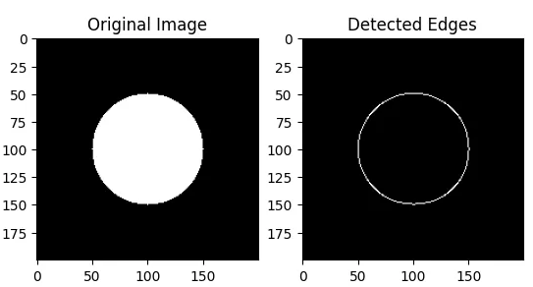
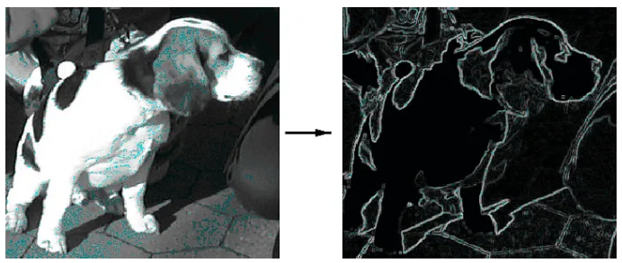
Types of Image Segmentation
Edge-based Segmentation
Edge-based segmentation techniques focus on detecting and utilizing the edges in an image to define object boundaries. Edges represent significant changes in pixel intensities and can be detected using edge detection algorithms such as Sobel, Canny, and Laplacian of Gaussian.
Once edges are detected, region-based segmentation methods can be applied.Edge-based segmentation offers accurate object localization but can be sensitive to noise and requires well-defined edges. It finds applications in medical imaging, object recognition, and video analysis.

Slide 23
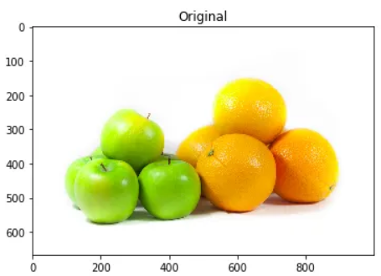
Types of Image Segmentation
Clustering-based Segmentation
Clustering-based segmentation techniques aim to group similar pixels or regions or colors together based on their features. Common clustering algorithms used for image segmentation include K-means and Mean Shift. Color-based clustering methods group pixels with similar color values, while texture-based clustering methods focus on grouping pixels with similar texture characteristics.
Clustering algorithms are used to group closer the data points that are more similar to each other, from other group data points.
As it is visible to our naked eye there are five color segments in the Image
The green part of Apples
The orange part of Oranges
Gray Shadows at bottom of the Apples and oranges
Bright Yellowish part of Apple’s top and right parts
White Background

Slide 24
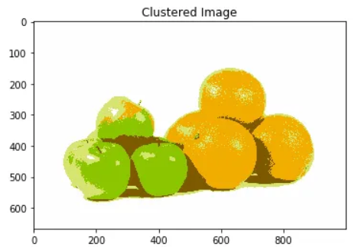
Types of Image Segmentation
Clustering-based segmentation is robust to variations in lighting conditions and can handle complex scenes with multiple objects. However, it requires careful feature selection, suffers from sensitivity to noise, and may produce over-segmentation or under-segmentation. Examples of clustering-based segmentation include segmenting objects in natural scenes, satellite imagery analysis, and image-based object tracking.

Slide 25
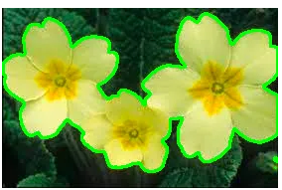
Types of Image Segmentation
Region-based Segmentation
Region-based segmentation techniques divide an image into meaningful regions by considering both local and global information. Watershed and Graph Cuts are popular algorithms used for region-based segmentation.
Region-based segmentation is useful for segmenting objects with irregular shapes and dealing with occlusions. However, it can suffer from over-segmentation, resulting in excessive regions. Post-processing techniques, such as merging or filtering, are often applied to refine the segmentation results. Region-based segmentation finds applications in medical imaging (e.g., tumor segmentation) and scene understanding tasks (e.g., object recognition, image-based modeling).

Slide 26
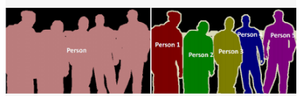
Types of Image Segmentation
Semantic Segmentation and Instance Segmentation
Semantic segmentation aims to assign semantic labels to each pixel in an image, providing a detailed understanding of the scene. It differs from other segmentation techniques by focusing on object-level labeling rather than individual regions. Deep learning-based approaches, particularly Convolutional Networks (CNNs), have achieved significant advancements in semantic segmentation.
Instance Segmentation
Instance segmentation goes beyond semantic segmentation by not only labeling each pixel with object categories but also differentiating individual instances of objects within the same category. Techniques such as Mask R-CNN combine object detection with segmentation to achieve instance-level segmentation. Object detection algorithms identify object bounding boxes, and then, segmentation networks generate pixel-wise masks for each detected object.

Slide 27
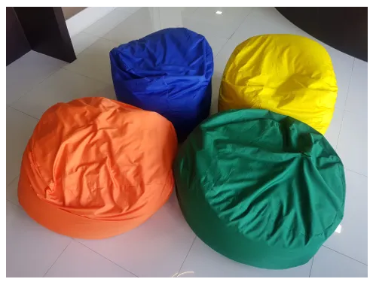
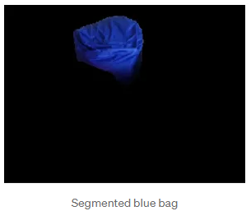
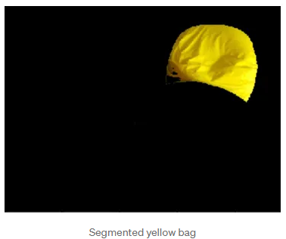
Types of Image Segmentation
Image Segmentation Using Color Spaces
The goal is we have a bunch of colors in our image and we would like to segment pixels based on the specific color.
Our goal here is to segment each bean bag through the HSV color space.

Slide 28
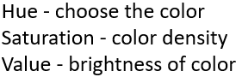
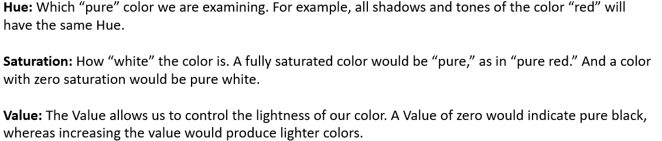
HSV Color Space
https://stackoverflow.com/questions/10948589/choosing-the-correct-upper-and-lower-hsv-boundaries-for-color-detection-withcv/48367205#48367205

Slide 29
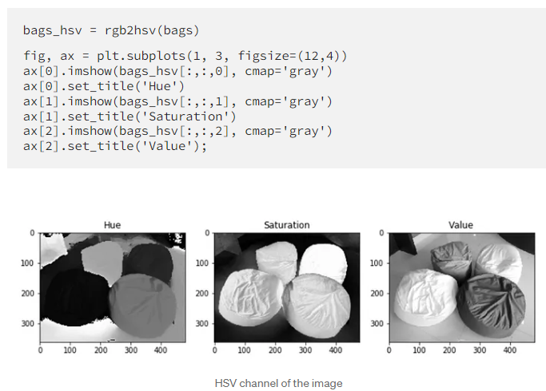
HSV Color Space

Slide 30
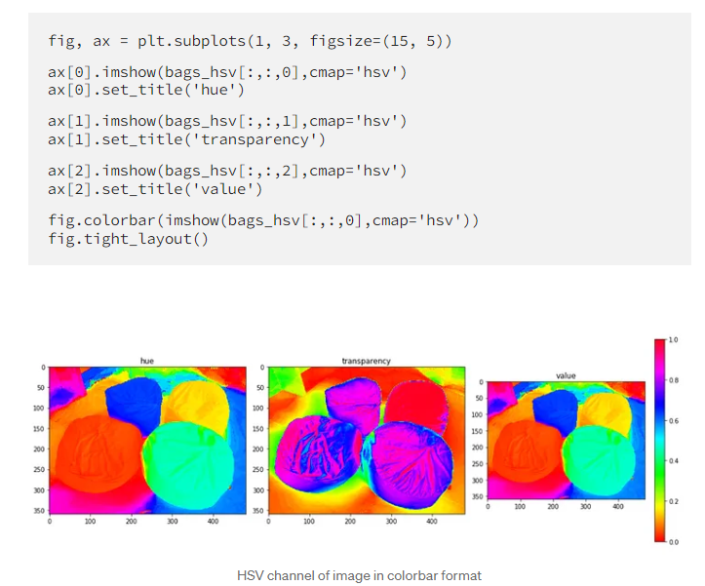
HSV Color Space

Slide 31



Dilation Vs Erosion
Morphological Operations.
Morphology is a broad set of image processing operations that process images based on shapes
Original Image
Dilation
Erosion
Notes:
https://vincmazet.github.io/bip/mm/measure.html

Slide 32
Image Augmentation

Slide 33
Image Augmentation
Data augmentation is a technique of artificially increasing the training set by creating modified copies of a dataset using existing data. It includes making minor changes to the dataset or using deep learning to generate new data points.
Augmented vs. Synthetic data
Augmented data is driven from original data with some minor changes. In the case of image augmentation, we make geometric and color space transformations (flipping, resizing, cropping, brightness, contrast) to increase the size and diversity of the training set.
Synthetic data is generated artificially without using the original dataset. It often uses DNNs (Deep Neural Networks) and GANs (Generative Adversarial Networks) to generate synthetic data.
Note: the augmentation techniques are not limited to images. You can augment audio, video, text, and other types of data too.
Notes:
GAN

Slide 34
Image Augmentation
When Should You Use Data Augmentation?
To prevent models from overfitting.
The initial training set is too small.
To improve the model accuracy.
To Reduce the operational cost of labeling and cleaning the raw dataset.
Limitations of Data Augmentation
The biases in the original dataset persist in the augmented data.
Quality assurance for data augmentation is expensive.
Research and development are required to build a system with advanced applications. For example, generating high-resolution images using GANs can be challenging.
Finding an effective data augmentation approach can be challenging.
Advanced Techniques
Generative adversarial networks (GANs): used to generate new data points or images. It does not require existing data to generate synthetic data.
Neural Style Transfer: a series of convolutional layers trained to deconstruct images and separate context and style.

Slide 35
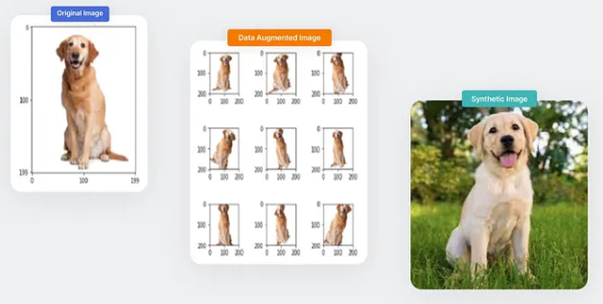
Image Augmentation

Slide 36
Reading Activity
https://blogs.nvidia.com/blog/what-is-synthetic-data/

Slide 37
Disclaimer
Due to nature of the course, various materials have compiled from different open source resources with some moderation. I sincerely acknowledge their hard work and contribution

Slide 38


